Slide 1

ECE 411
Computer Organization & Design
MP2, MP3
Jiaqi Xing & Tianyi Meng

Slide 2
Topics
- Design review of MP2
The implementation of MP2
Test benches and simulation results
FPGA implementation and timing analysis
Proposal for MP3
- The design plan to add 5 stage pipeline in MP2
- The conflict may meet in this design
- My solutions to address issues
- The contribution of each member

Slide 3
Part 1. Design review of MP2

Slide 4
1.1 The implementation of MP2
Cache specification:
In this project, we designed a one-level, unified, 2-way set-associative cache with the following specification, the following are mentioned in the lab document:
● 8 lines per way with 8 words per line (i.e. total of 8 sets with 2 ways per set)
● Write-back with a write allocate policy
● LRU replacement policy （least recent used）
● Read/Write hit takes exactly two clock cycles to complete
● 4 control states in cache controller
● The memory bandwidth is 256-bits so that a single load will fill a whole cache line.
● Memory address is 32-bit wide. Offset = address[4:0], Index = address[7:5], Tag = address[31:8]

Slide 5
1.1 The implementation of MP2
Components used:
● Control unit
● Decoders
● Comparators
● Muxes
● 4 byte to 32 byte bus adapter
● 2 Data store arrays
● Metadata arrays
○ 2 Tag store arrays
○ 2 Valid bit arrays
○ 2 Dirty bit arrays
○ LRU bit array
● Logic gates
● Registers

Slide 6
1.1 The implementation of MP2
Memory hierarchy signals:
The first part of signal is memory hierarchy signals, which include signals between CPU Datapath and Cache and signals between Cache and main memory.
Signals between CPU Datapath and Cache includes mem_address[31:0], mem_rdata[31:0], mem_wdata[31:0], mem_read, mem_write, mem_byte_enable[3:0], mem_resp. Signals between Cache and main memory includes pmem_address[31:0], pmem_rdata[255:0], pmem_wdata[255:0], pmem_read, pmem_write, pmem_resp. Detailed explanation for these signals can be found in the mp2 document.

Slide 7
1.1 The implementation of MP2
Cache signals：
The second part of signals in our design include signals that we designed between cache control, cache datapath and bus adapter. Following are the explanation for these signals:

Slide 8
1.1 The implementation of MP2
Cache signals：
a. Signals between cache control and cache datapath:
● dirty_way1: Dirty bit read from way 1 at index.
● dirty_way2: Dirty bit from way 2 at index.
● hit_way1: Indicate hit from way 1 at index.
● hit_way2: Indicate hit from way 1 at index.
● LRU_r: Indicate the LRU at index.
● load_valid: Determine to load new data to array for valid or not.
● load_tag: Determine to load new data to array for tag or not.

Slide 9
1.1 The implementation of MP2
Cache signals：
a. Signals between cache control and cache datapath:
● load_dirty: Determine to load new data to array for dirty or not.
● load_LRU: Determine to load new data to array for LRU or not.
● load_block: Determine to load new data to array for block or not.
● way_det: Use to determine way 1 or way 2.
● tag_r: Determine to read from tag arrays or not.
● block_r: Determine to read from data arrays or not.
● dirty_w: Data written to dirty arrays.

Slide 10
1.1 The implementation of MP2
Cache signals：
Signals between cache datapath and bus adapter:
● cache_w[255:0]: Data written to cache.
● cache_r[255:0]: Data read from cache.
● cache_byte[31:0]: Determine the byte written to cache.

Slide 11
1.1 The implementation of MP2
Cache datapath：
The cache datapath includes 2 data store arrays, 7 metadata arrays, comparators, muxes, and logical gates. The datapath graph generated by Quartz is shown on the next two pages.

Slide 12
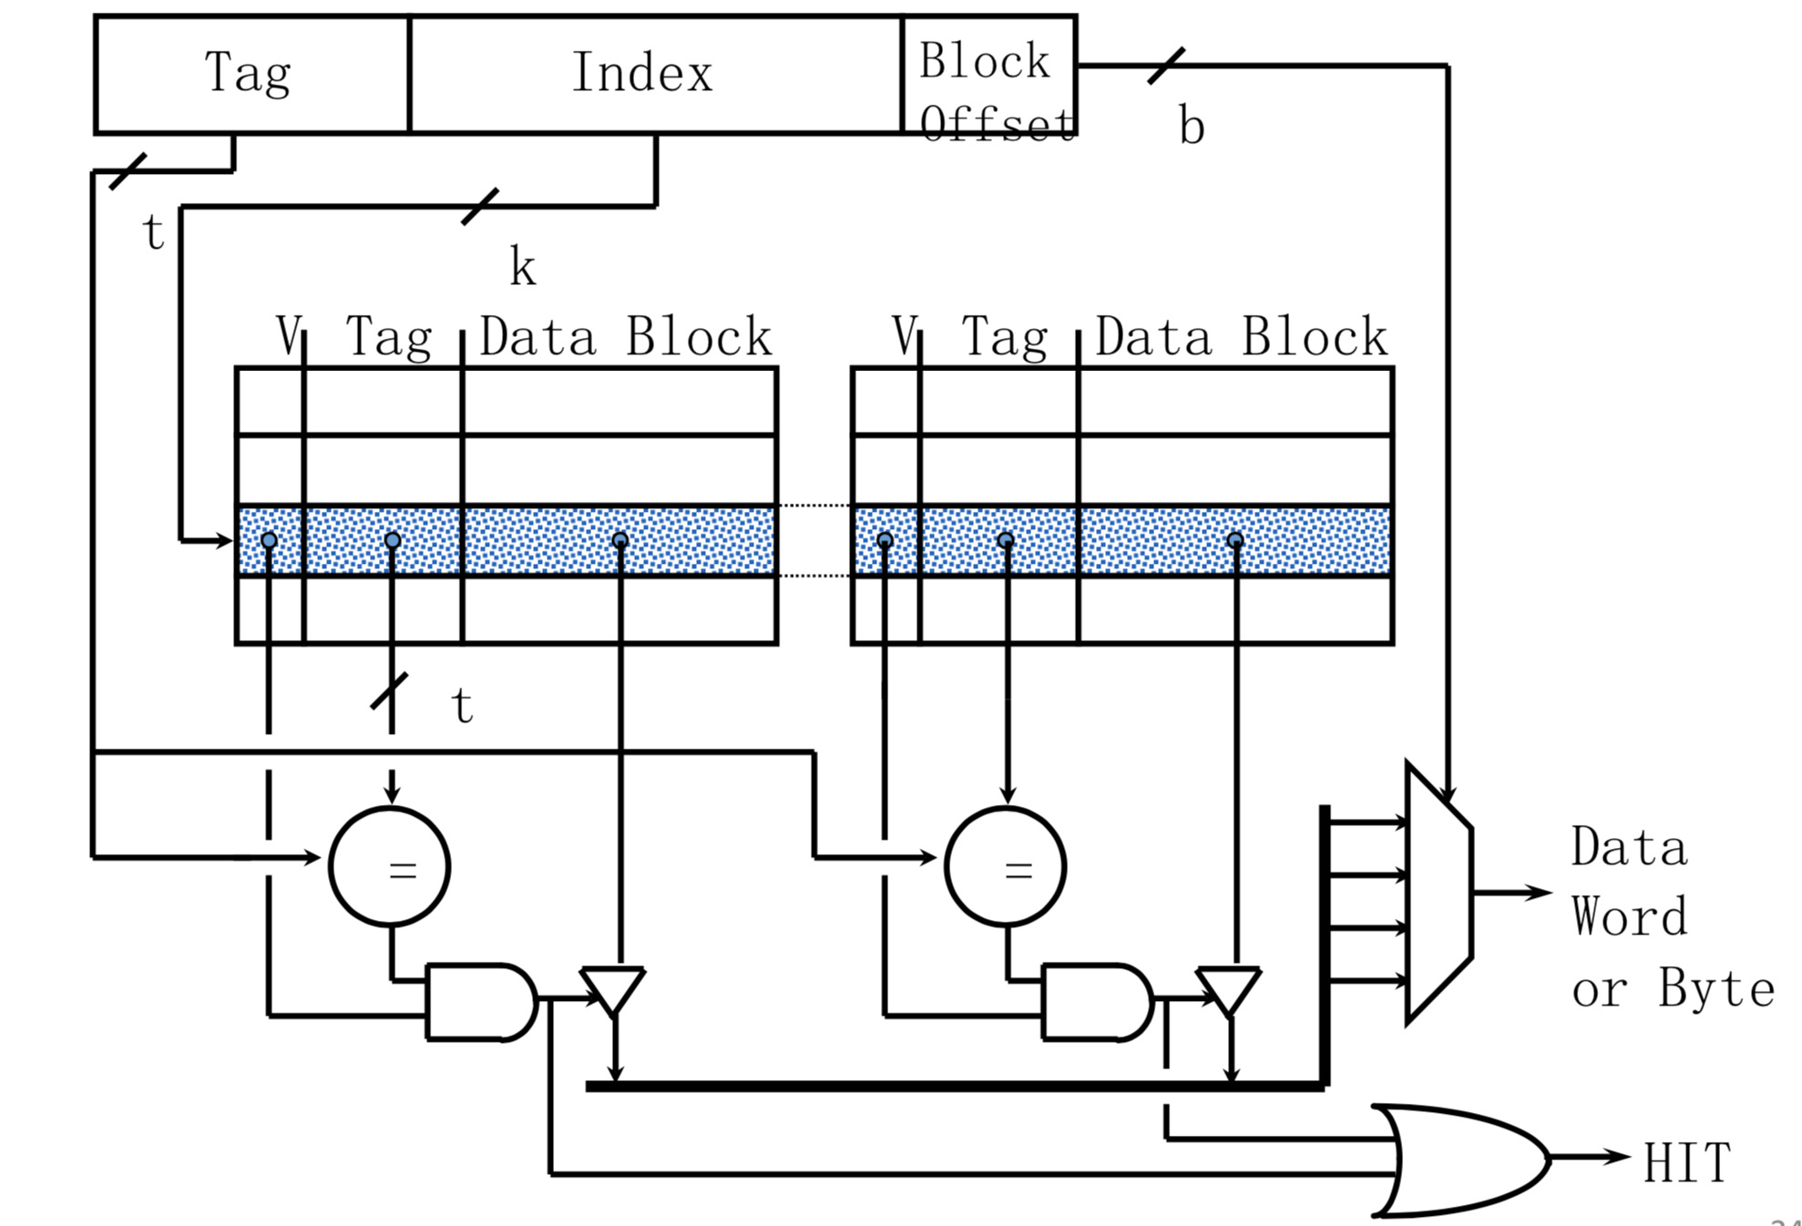
1.1 The implementation of MP2

Slide 13
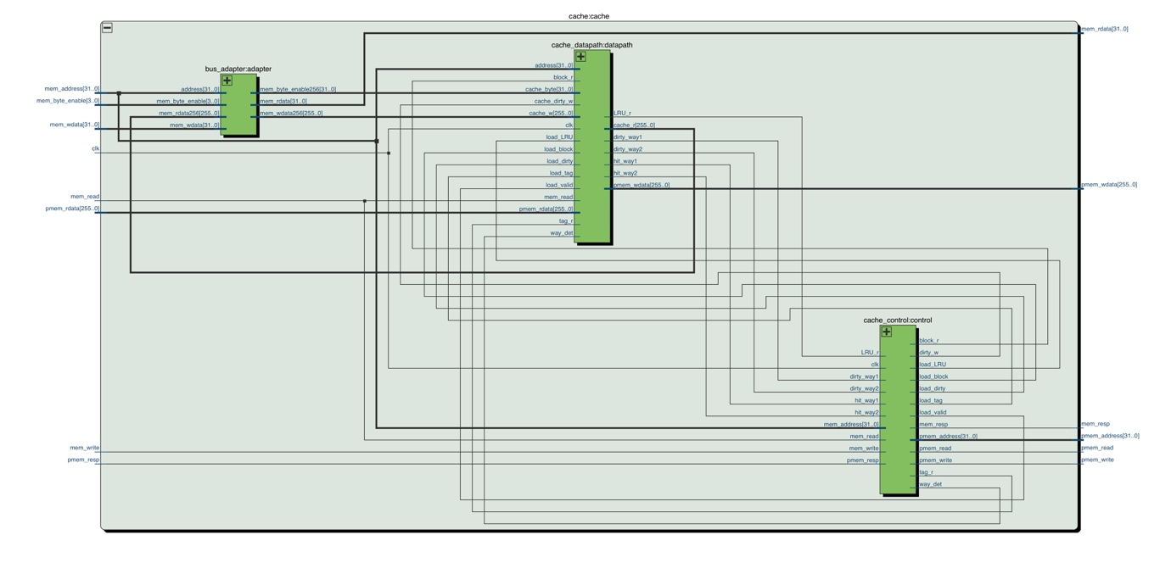
1.1 The implementation of MP2
Cache

Slide 14
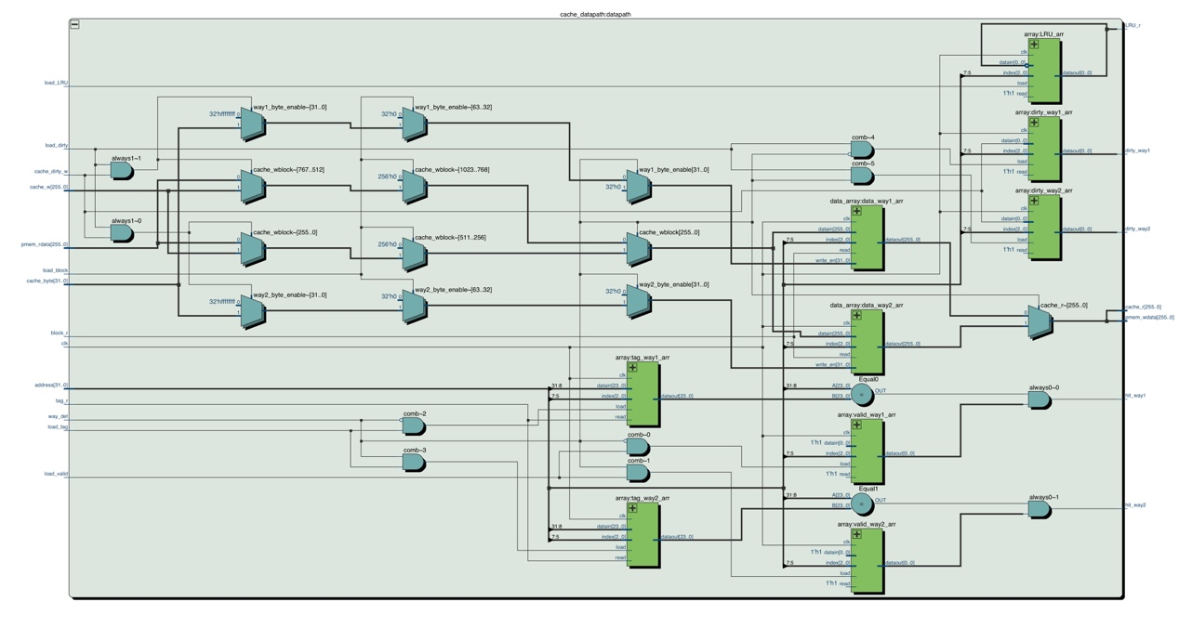
Cache datapath

Slide 15
1.1 The implementation of MP2
Cache controller：
Our controller is a Mealy state machine that uses the signals to control the data and data transmission.
There are basically four states in our state machine, as recommended in the document.

Slide 16
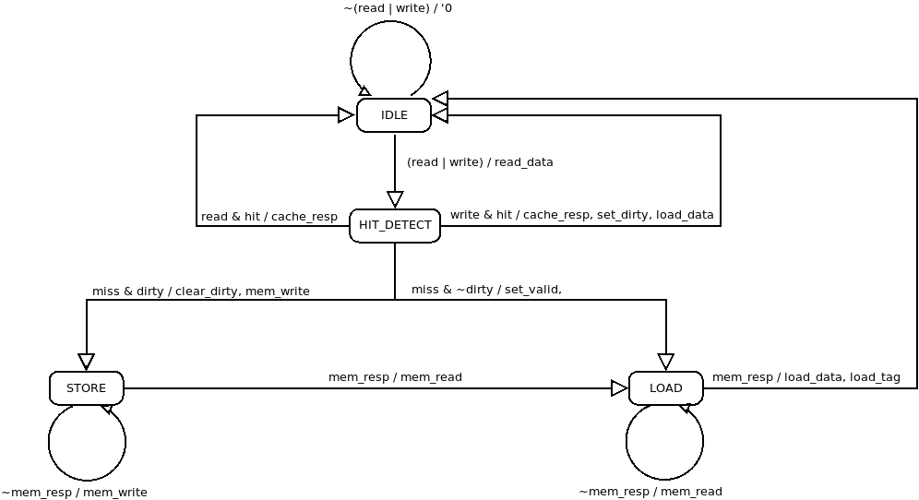
1.1 The implementation of MP2
Cache controller：A basic transition diagram

Slide 17
1.1 The implementation of MP2
Cache controller：Our specific transition diagram

Slide 18
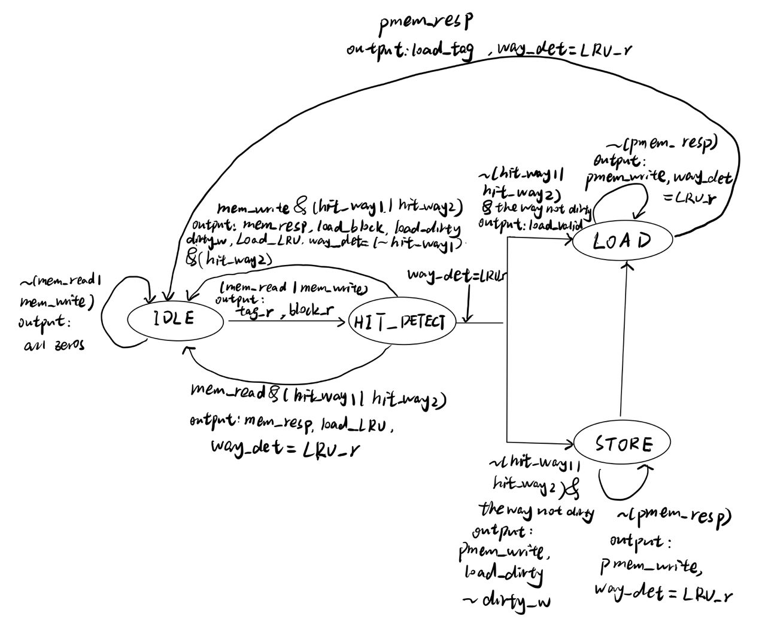

Slide 19
1.2 Test benches and simulation results
Basically, we use the Default source testbench to test our design. This test testbench tests sw, lw, lui, br, auipc and arithmetic operations between registers and immediate.

Slide 20
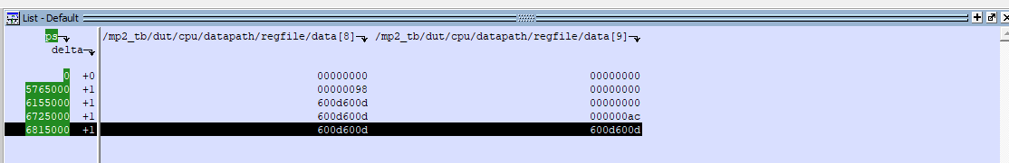
1.2 Test benches and simulation results
As the figure shows, the test pass since x8 is finally 0x600d600d. So our design is correct.

Slide 21
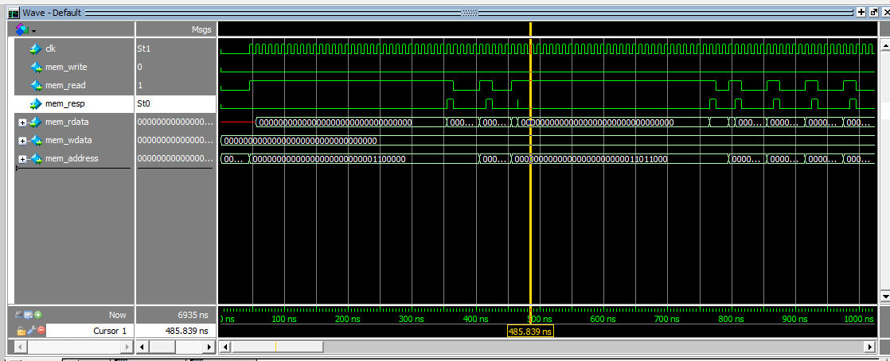
1.2 Test benches and simulation results
Waveform for read operation: the first read lasts for a little more cycles.
And the other read operations last for two clock cycles.

Slide 22
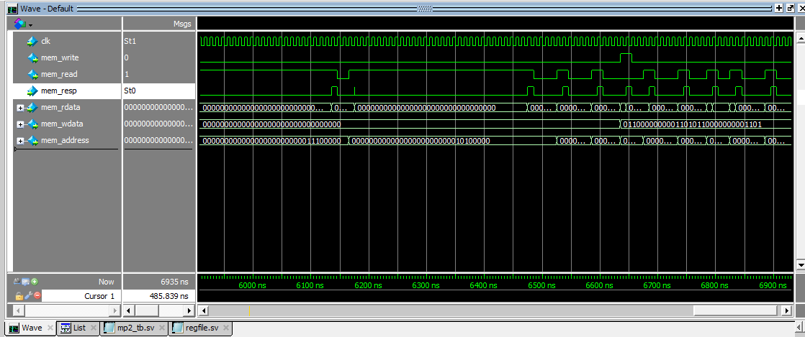
1.2 Test benches and simulation results
Waveform for write operation: the write process also lasts two clock cycles,
which satisfies the requirement of our project.

Slide 23
1.3 FPGA implementation and timing analysis
I have four timing analysis report for 10 MHz, 50 MHz, 75 MHz and 100 MHz.
Our design is able to run 75 MHz, while fails to run 100 MHz. So our performance is between 75 MHz and 100 MHz.

Slide 24
Part 2. Proposal for MP3

Slide 25
2.1 The design plan of 5 stage pipeline
The goal of this project was to create a traditional five-stage pipelined processor with split L1 caches and a unified L2 cache.

Slide 26
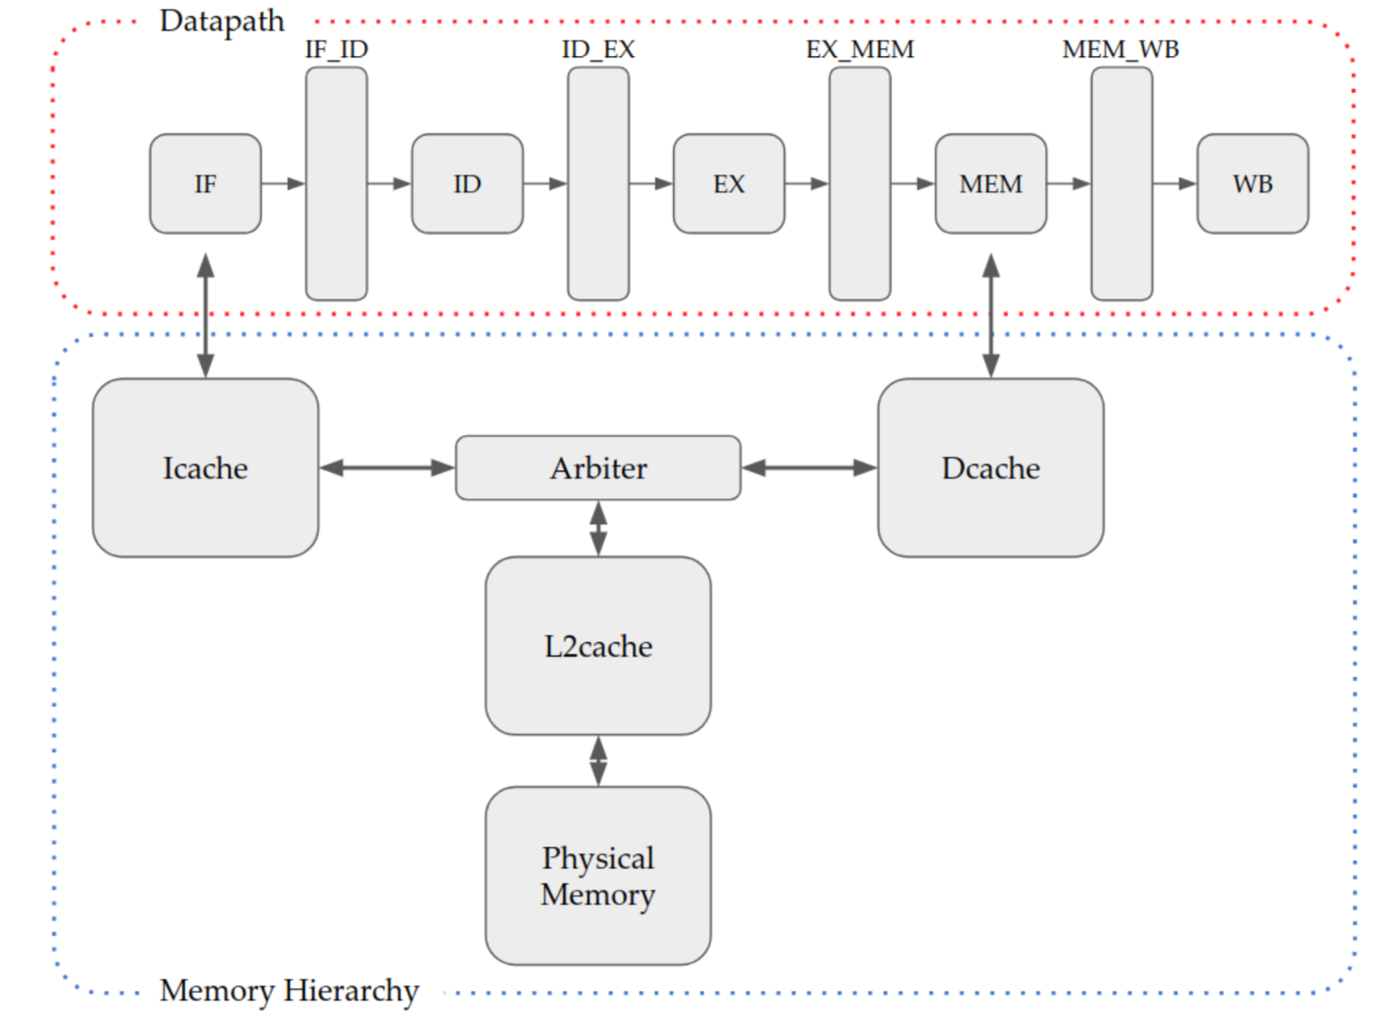
2.1 The design plan to add 5 stage pipeline in MP2

Slide 27
2.1 The design plan of 5 stage pipeline
IF: Fetch the instructions
component used: Instruction memory, adder
ID: Decode
Component used: instruction decoder register file
EX: Execute
Component used: ALU, extender
MEM: Access memory
Component used: data register
WB: write back
Component used: register file

Slide 28
2.1 The design plan of 5 stage pipeline
Icache: Instruction cache
Dcache: Data cache
Arbiter: Determine the priority of Icache and Dcache
L2cache: Level 2 cache

Slide 29
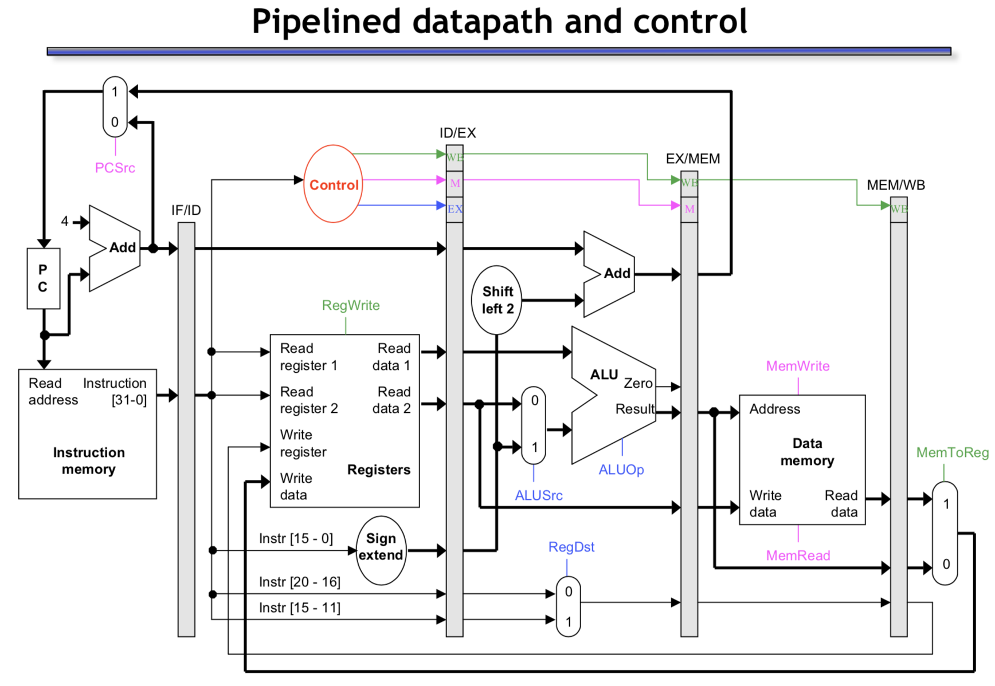
2.1 The design plan of 5 stage pipeline

Slide 30
2.2 The conflict may meet in this design
•An instruction may depend on something produced by an earlier instruction
– No structural hazard in RV32I
– Dependence may be for a data value →data hazard
– Dependence may be for the next instruction’s address →control hazard (branches, exceptions)
• Handling hazards generally introduces bubbles into pipeline and reduces ideal CPI > 1

Slide 31
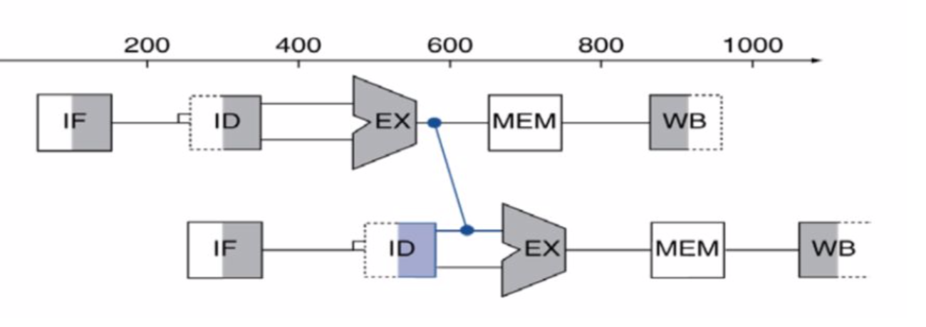
2.2 The conflict may meet in this design & 2.3 My solutions to address issues
• Data Hazards
– Register access: write-then-read write at rising edge and read at falling edge
– ALU results: forwarding (bypassing) add lines between stages
– Load data harzards: stalling
and rescheduling

Slide 32
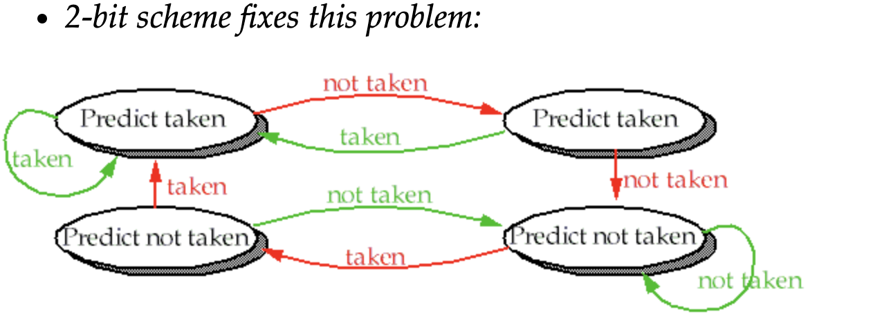
2.2 The conflict may meet in this design & 2.3 My solutions to address issues
• Control Hazards
– Branch prediction
Static branch prediction: Assume not branch at first, if true, continue to run normally; if false, make all instruction fetched to be nope by setting some signals
Dynamic prediction: based on the
branch history

Slide 33
Part 3. The contribution of each member

Slide 34
3. The contribution of each member
Jiaqi Xing：mp2 design and report, mp3 preparation and presentation
Tianyi Meng: mp2 design and code

Slide 35
Thank you!

